Slide 1
BMM & BMA INDUSTRIAL TRAINING BRIEFING 2023 Siri 2: During & After Industrial Training
DATE:07/06/2023
TIME: 2030-2230
LOCATION: MICROSOFT TEAM
BY:
DR. HADI ABDUL SALAAM (BMM LI COORDINATOR)
DR. NOR ATIQAH ZOLPAKAR (BMA LI COORDINATOR)

Slide 2
Before we go further…..
Let me introduce you what is United Nation Sustainable Development Goals
Why you need to know? Because you need to include/relate the project/job/task given to you with United Nation Sustainable Development Goals (Compulsory - especially related to environment)
How to relate? Any suggestion/decision made by you / your industrial sv must write (any point) relate to UN SDG.
For further reading, kindly search “United Nation Sustainable Development Goals” by using google.

Slide 4
Reminder:
As at 07/06/2023 0930 am, only 42 students completed getting industrial training place and key in in the system.
Those who did not getting the place, kindly take an urgent immediate actions to find and secure a correct place and key in the info in your ecom.

Slide 5
What student need to do during industrial training period?
Fill in and send A1 form to li@ump.edu.my in the first (1st) week of industrial training period.
Write logbook daily in a proper manner as an engineer; not as a students
Write a complete and comprehensive LI report
Contact appointed lecturer (UMP SV) and arrange for assessment after LI Coordinator give green light
Submit Form C (industrial SV evaluation form if sv give to you)
All MC and leave MUST get approval from company; not UMP and being recorded in your logbook

Slide 6
Form A1
Can be retrieve at : https://cpdc.ump.edu.my/index.php/en/li/documents/word/3-a1-form-validation-report/file
Submit on the first week of industrial training period to li@ump.edu.my

Slide 7
Logbook
Can be retrieve at: https://cpdc.ump.edu.my/index.php/en/li/documents/pdf/log-book-li/83-buku-log-li-2021-26072021-final/file
Daily activity based on project/job/task given by industrial supervisor MUST be recorded
Industrial SV MUST sign weekly assessment. If not, your logbook will not be accepted.

Slide 9
Logbook
Need to be written daily basis
Need to be given to industrial supervisor to sign and give marks based on scale 1-5 for each week
Content to be written in logbook: Problem(s), Analysis of problem(s), proposed solutions, selected solutions, justification of the selected solution.
Must include figure (where necessary for a better understanding) and references.

Slide 10
Example:
Very poor logbook writing.
Did not meet engineering writing style.
Must include problem(s), option methods to solve it and final solution taken and MUST relate to UN SDG

Slide 11
Example:
Not a good example because it only have problem and methods taken.
Must include reference and relate to UN SDG

Slide 12
Logbook Evaluation Form

Slide 13
LI Report
Must be submitted after one (1) week completed industrial training.
Summary of industrial training project/job/task – example air conditioning troubleshoot maintenance & Car trouble shooting and maintenance.
Full complete LI report format will be distribute later.

Slide 14
LI Report Format
Item 8-12; minimum 55 pages for you to get a good marks in your report writing; below than that, sorry!

Slide 15
Very Poor LI Report Example:
Not meet minimum 55 pages from introduction to conclusions chapter
Did not follow LI report writing format. (Justify paragraph, no List of figure, List of Table & etc)
Did not put figure/table numbering title, did not mention figure number in main text with detail explanations.
No reference in main text and list of reference although obtain company info through the website.

Slide 16
LI Report Assessment

Slide 18
LI Presentation Assessment
UMP lecturer (sv) will visit student after 5 weeks of industrial training on words.
Student MUST present to UMP SV when they visit to the company or they schedule it online. If not, you will get 0 for this assessment.
Industrial SV are encourage to attend the presentation session if they are free at that time.
What to be presented?

Slide 19
LI Presentation Assessment

Slide 21
Form C (Industrial SV evaluation form)
Can be retrieve at: https://cpdc.ump.edu.my/index.php/en/li/documents/word/24-form-c-industrial-supervisor-report/file
MUST be fill in by industrial SV.
After industrial sv complete fill in the form, kindly negotiate with them either to submit the form via students (will be upload into google form by student) or email it to: hadisalaam@ump.edu.my or noratiqahz@ump.edu.my
Although in the form stated the form can be return final week of industrial training, for a special case; the industrial training coordinator may ask industrial sv to submit earlier via students or directly email to the BMM/BMA industrial training coordinator.
Preferable not send by post.

Slide 22
Form C (Industrial SV evaluation form)

Slide 24
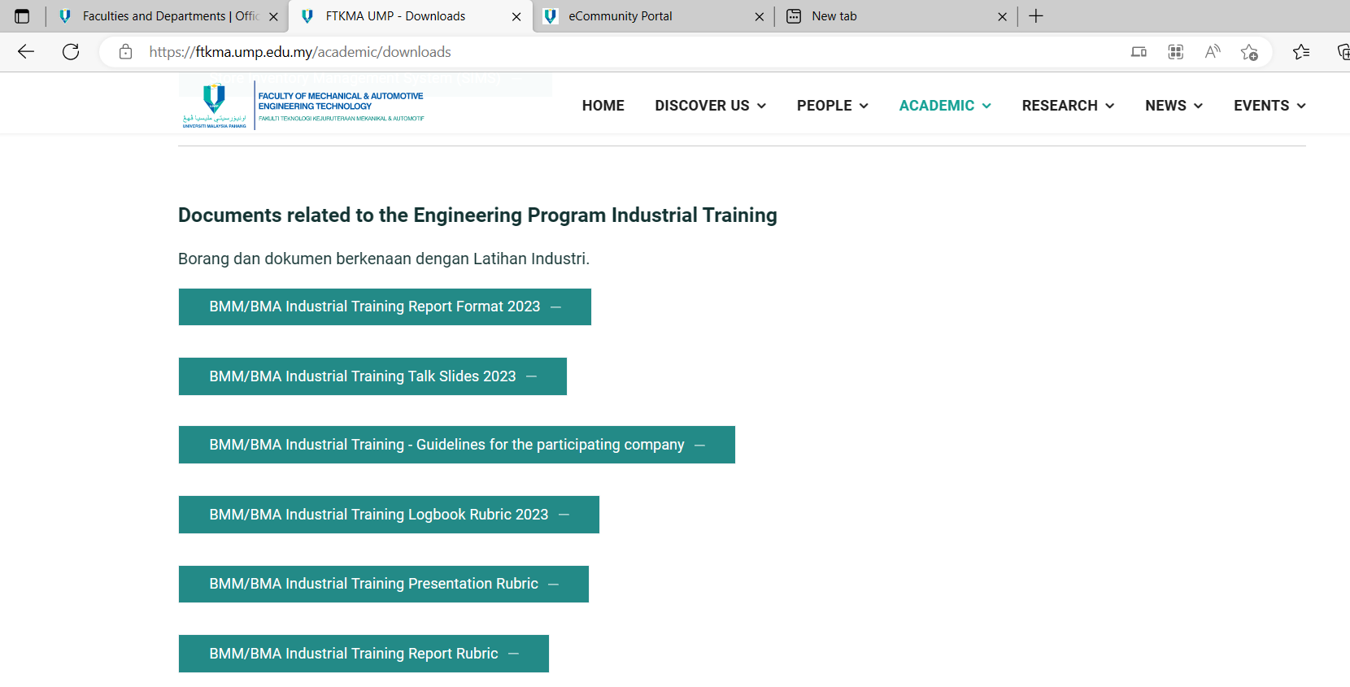
Where to download most of the assessment documents?
FTKMA UMP - Downloads

Slide 25
WARNING!!!!
It is COMPULSARY for the students to submit the complete Logbook and LI report softcopy when being ask to do so by industrial training coordinator.
FAIL to do so; student results will be proposed FAIL (HG Status) for the overall industrial training although assessment marks by UMP & Industrial SV already being completed.
WHY? It is because when engineering accreditation council (EAC) panels come to do audit, if they find out marks are given but no proof; it will jeopardize the whole batch accreditation results.

Slide 26
Thank You. Any Question?

